Slide 1


Early Detection of Anomaly using Side-Channel: Statistics and Learning
Manaar Alam
Secured Embedded Architecture Laboratory (SEAL)
Department of Computer Science and Engineering
Indian Institute of Technology Kharagpur
alam.manaar@iitkgp.ac.in
Workshop on Advanced Side-Channel Evaluation of Hardware Security (ASCEHS), IIT Kharagpur

Slide 2

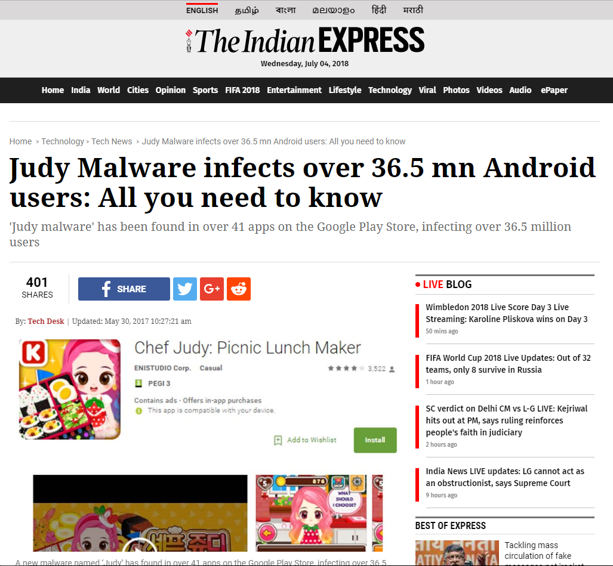
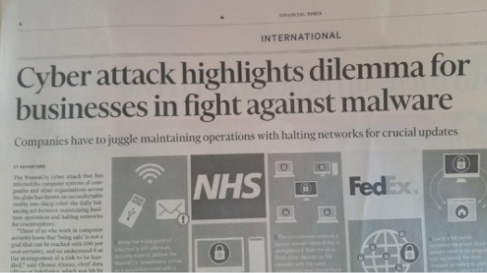
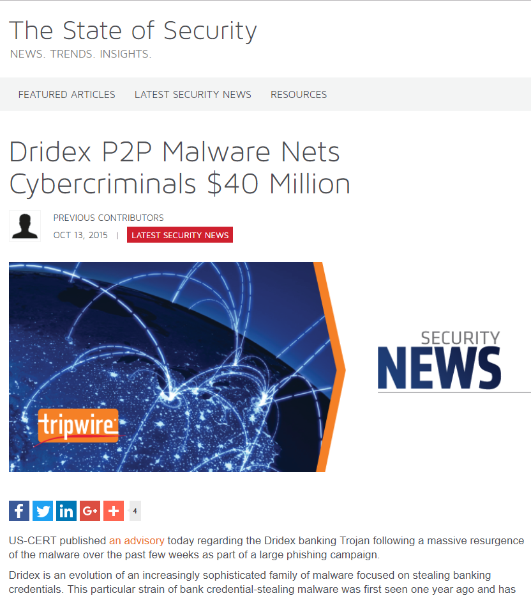
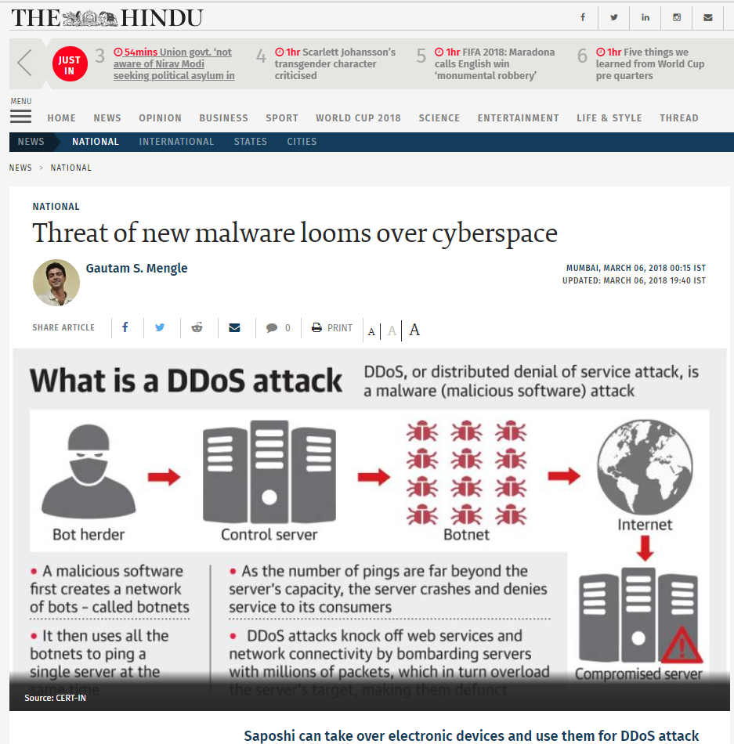


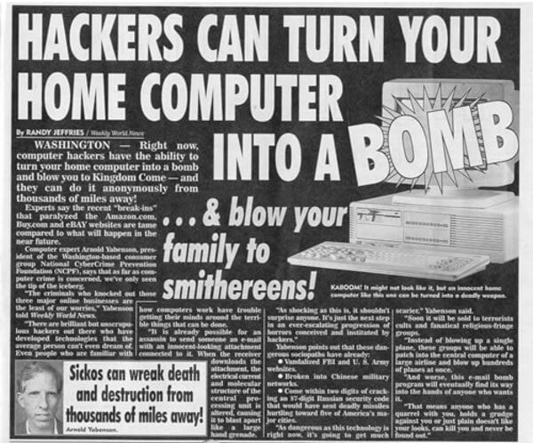


2

Slide 3






Trojans
Appears useful but works maliciously in the background
Ransomwares
Holds a computer system captive while demanding a ransom
People’s computers are not getting more secure. They’re getting more infected with viruses. They’re getting more under the control of malware.
Avi Rubin
(at TEDxMidAtlantic)
Rootkits
Gains remote access while hiding its presence
Worms
Replicates in the system independently while destroying it
Keylogger
Secretly logs keystrokes to steal personal information
Spyware
Tracks user activities

Slide 4

Why their Detection is Important?
Many detection schemes
Static Analysis
Unknown malware could easily bypass this scheme of prevention.
Behavioural Analysis
Existence of false positives and false negatives.
The occurrences of newer varieties of malicious codes and their nature proves that the designing of a generalised detection mechanism is an extremely difficult problem.

Slide 5
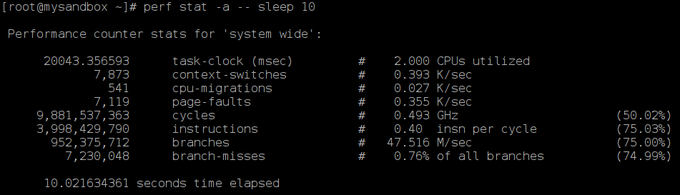
Hardware Performance Counters
Set of special purpose registers, present in most of the microprocessor's Performance Monitoring Unit (PMU).
Store hardware and software events related to the execution of a program, such as cache misses, retired instructions, retired branch instructions, etc.
Type and number of hardware events vary across different Instruction Set Architectures (ISA).
Various open-source tools can measure this HPC values: perf tools, PAPI, OProfile, Valgrind and many more.
Values
Events

Slide 6

Related Works
[1] and [3] uses system calls, [2], [4], and [5] uses hardware performance counters in their approach.
[2] and [3] require kernel level modification for their method.
[5] considered only a particular set of malwares.
[1] detects malware in Android system, but, none of the techniques are suitable for low resource constraint devices.
[1] S. Das, Y. Liu, W. Zhang, and M. Chandramohan, “Semantics-based online malware detection: towards efficient real-time protection against malware,” IEEE transactions on information forensics and security, vol. 11, no. 2, pp. 289–302, 2016.
[2] X. Wang and R. Karri, “Reusing hardware performance counters to detect and identify kernel control-flow modifying rootkits,” IEEE Transactions on Computer-Aided Design of Integrated Circuits and Systems, vol. 35, no. 3, pp. 485–498, 2016.
[3] M. Ozsoy, K. N. Khasawneh, C. Donovick, I. Gorelik, N. Abu-Ghazaleh, and D. Ponomarev, “Hardware-based malware detection using low-level architectural features,” IEEE Transactions on Computers, vol. 65, no. 11, pp. 3332–3344, 2016.
[4] X. Wang, C. Konstantinou, M. Maniatakos, and R. Karri, “Confirm: Detecting firmware modifications in embedded systems using hardware performance counters,” in Computer-Aided Design (ICCAD), 2015 IEEE/ACM International Conference on. IEEE, 2015, pp. 544–551.
[5] S. Das, B. Chen, M. Chandramohan, Y. Liu, and W. Zhang, “Ropsentry: runtime defense against rop attacks using hardware performance counters,” Computers & Security, 2017.

Slide 7
LAMBDA: Lightweight Assessment of Malware for emBeddeD Architectures

Slide 8
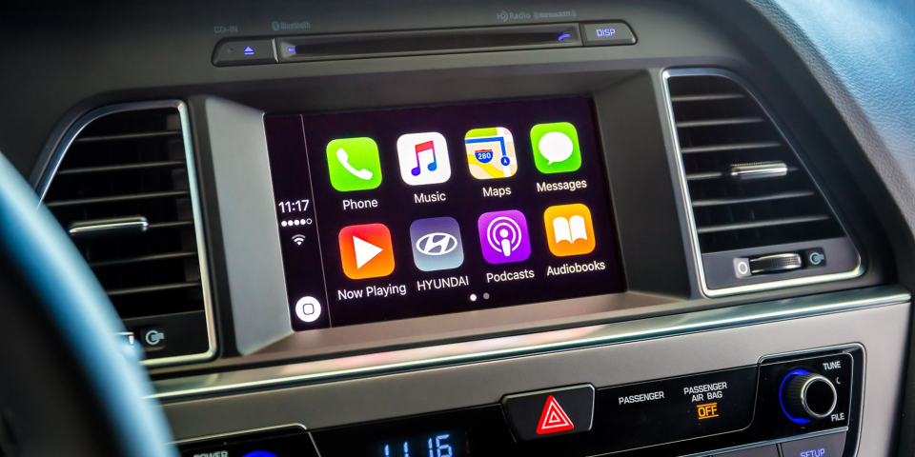


Why going for Embedded System?
Advantage
We can safely assume that in most of the Embedded System, the type of benign applications are limited.
A basic music system will only support .mp3 applications.
Difficulty
Often these platforms are resource constrained and runs very simple embedded Linux.
Complex detection mechanism with sophisticated libraries may not work on most of the system.

Slide 9
Idea of LAMBDA
We present the scheme LAMBDA for embedded platforms which aim to support a restricted set of benign programs, or benign reference points.
We used a [0, 1] distance metric 𝜆 to quantify the amount of “malwareness” of an executable in comparison to the benign reference points.
The basic notion is that for an unknown PUT, if its distance from the set of the benign reference point is higher than some threshold value, the PUT is termed as a malware application, whereas PUT having distance lower than the threshold is termed as a benign application.
Benign Reference Points
𝜆

Slide 10
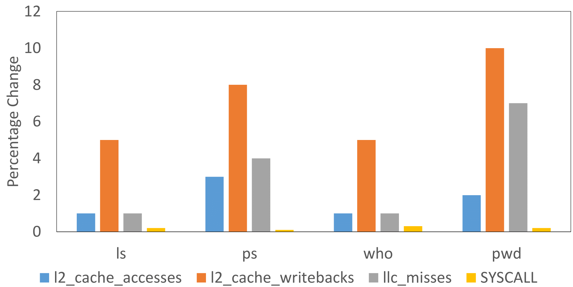
Defining Feature
The metric is defined by taking a combination of features.
Each feature is a tuple of higher-level system call and lower-level performance counters.
Advantage of taking combination
Disadvantage of System-call based approach is that it can be easily bypassed by new malwares.
Disadvantage of performance counters is that it may allow high number of false positives.
The combination of these two negates each others disadvantages.
Changes before and after the sutresu rootkit execution

Slide 11
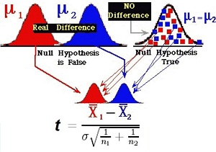
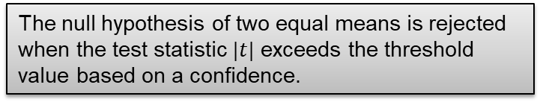
Hypothesis Testing to Identify Effective Features
Fundamental question is whether two sets of data are significantly different from each other.
Most common answer is Welch’s t-test.
The aim of test is to provide a quantitative value as probability that the mean of two sets are different.
The null hypothesis of two equal means is rejected when the test statistic $|t|$ exceeds the threshold value based on a confidence.

Slide 12
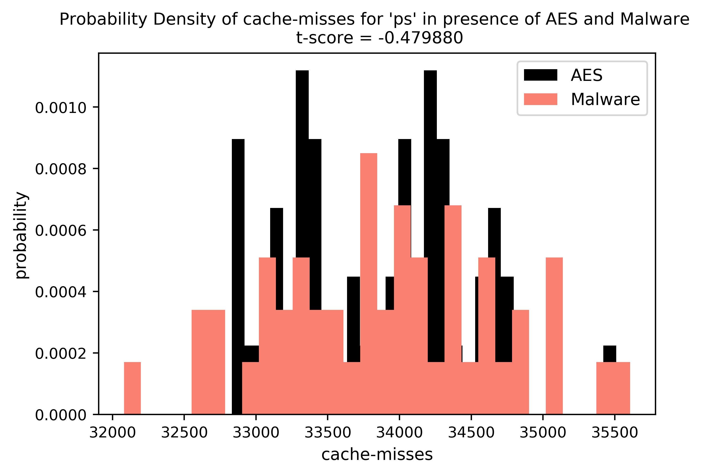
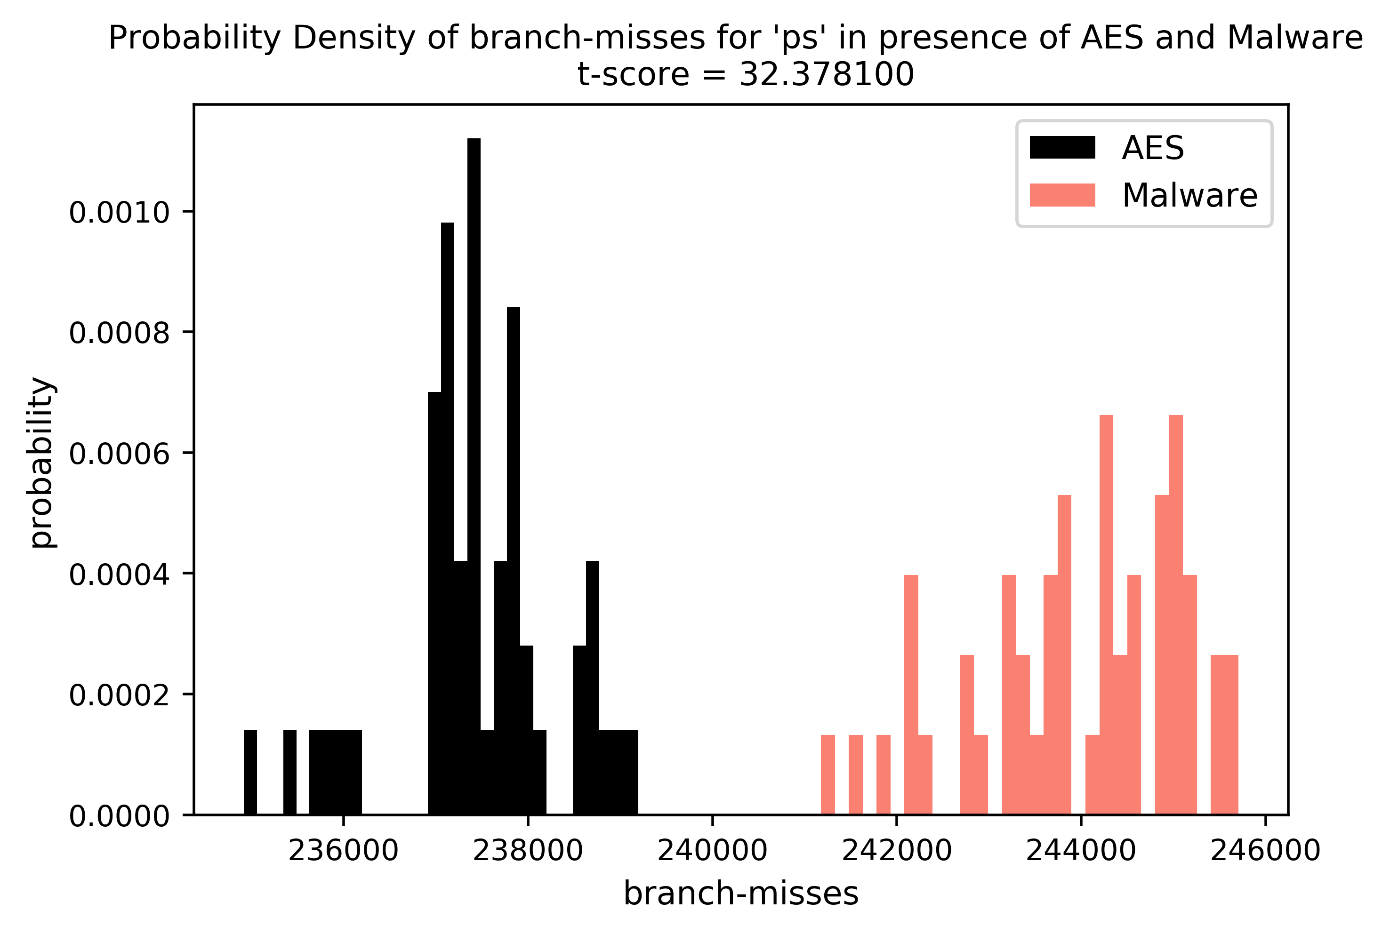
Importance of Selecting Good Feature
A feature may be insensitive. It may not be able to distinguish a malware from the benign applications.
Some other features may be sensitive enough to perform the task.
We do not discard the insensitive features, rather assign a suitable sensitivity value.
(ps, cache-misses)
(ps, branch-misses)

Slide 13
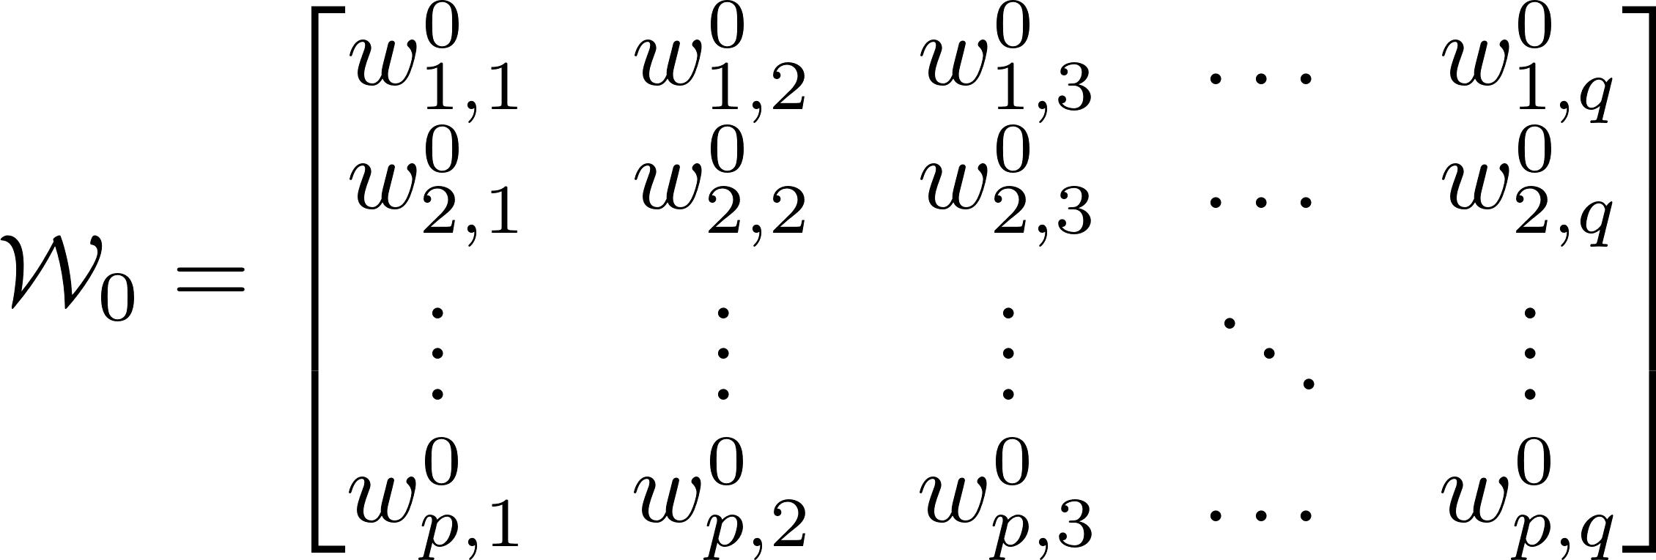
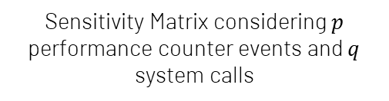
Assigning Sensitivity Value to each Feature
We assign sensitivity values to each feature by its capability to differentiate between a malware and a benign execution in an Offline analysis.
The differentiation is performed by applying t-test on the distribution of values corresponding to each feature.
Sensitivity of a feature is increased when it is able to differentiate more malwares from the benign reference point.
Sensitivity Matrix considering $p$ performance counter events and $q$ system calls

Slide 14
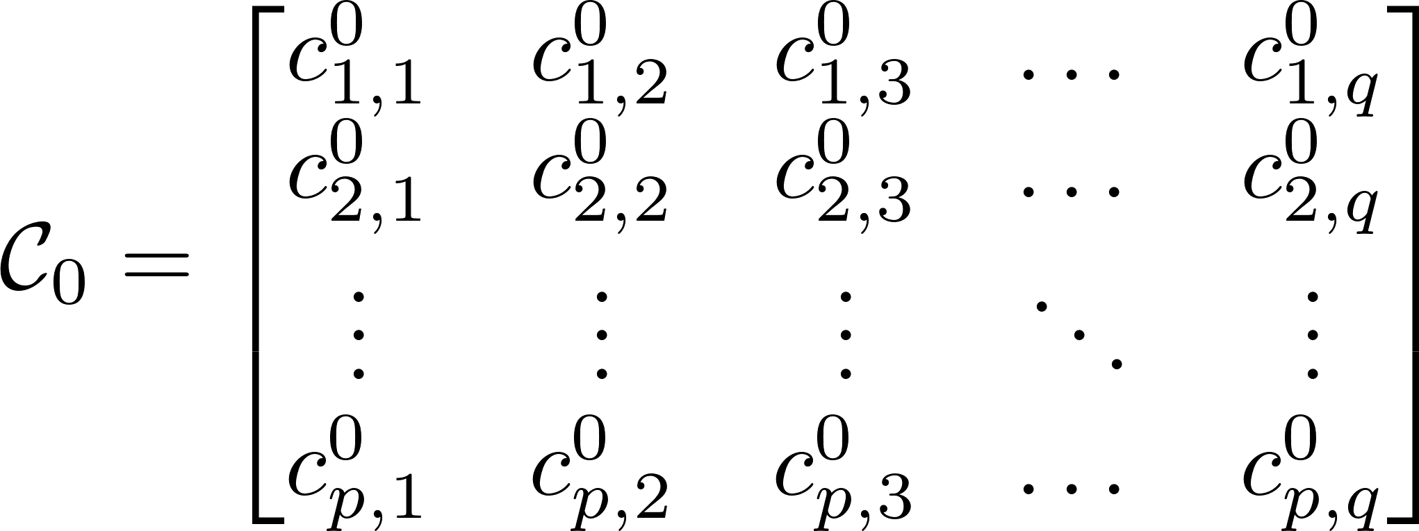
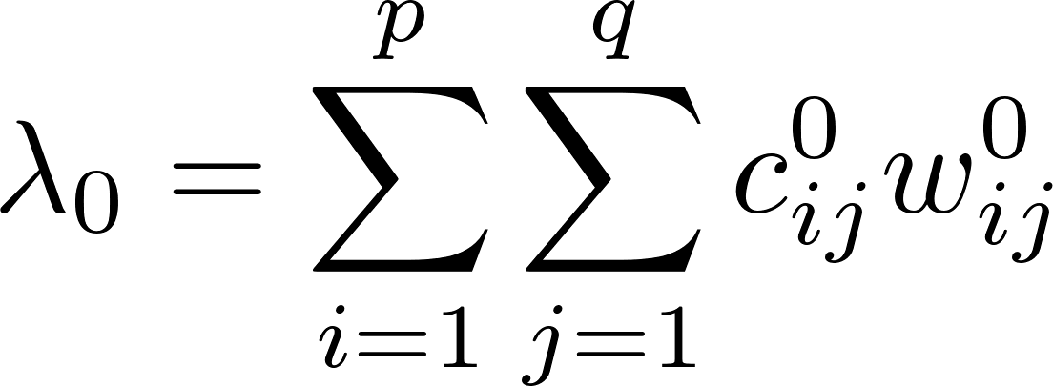

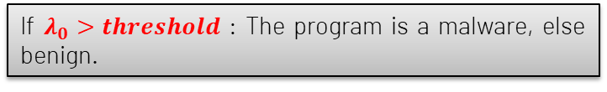
Idea of Distance Metric
We calculate Count Matrix for an unknown executable.
Each cell of the matrix represents a feature and signifies the number of times null hypothesis has been rejected by the feature considering benign reference point.
If $λ_{0}>threshold$ : The program is a malware, else benign.
Calculated using $3σ$ analysis on the $λ_{0}$ values of benign reference points

Slide 15
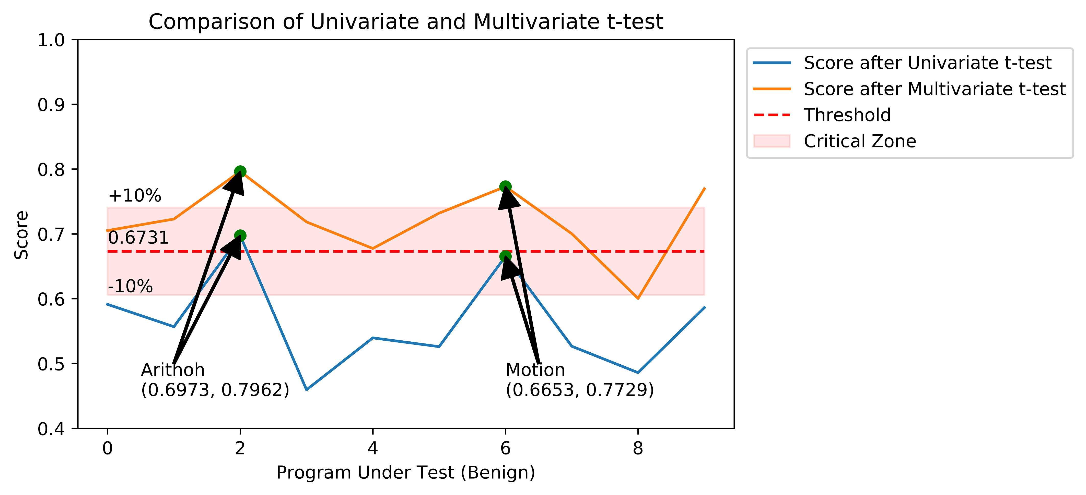
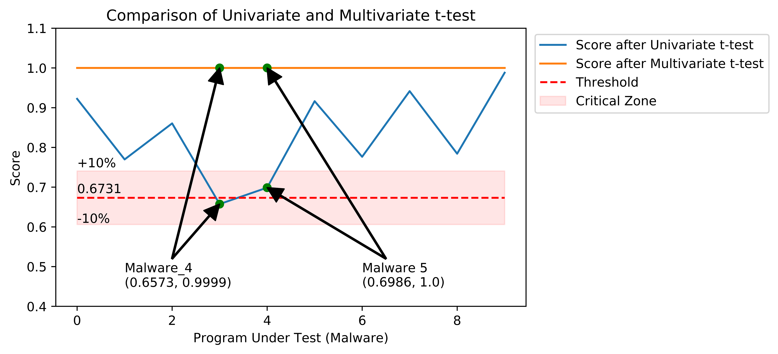
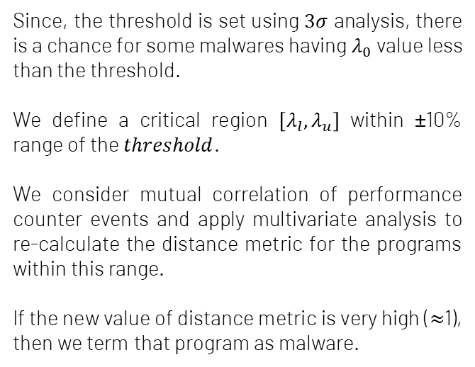
Multivariate Analysis
Since, the threshold is set using $3σ$ analysis, there is a chance for some malwares having $λ_{0}$ value less than the threshold.
We define a critical region $\left[λ_{l}, λ_{u}\right]$ within ±10% range of the $threshold$.
We consider mutual correlation of performance counter events and apply multivariate analysis to re-calculate the distance metric for the programs within this range.
If the new value of distance metric is very high ($≈$1), then we term that program as malware.
Removes false positives
Removes false negatives

Slide 16

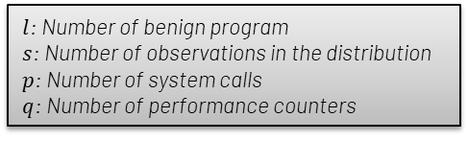
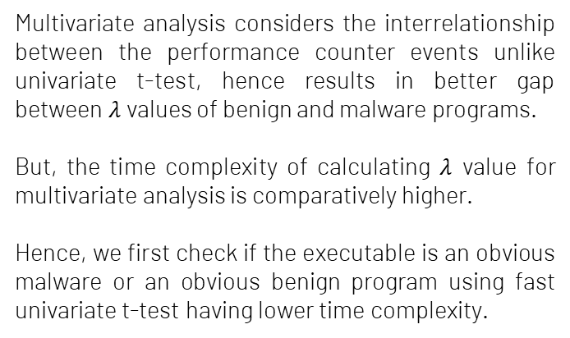
Importance of both the Tests
Time Complexity
Multivariate analysis considers the interrelationship between the performance counter events unlike univariate t-test, hence results in better gap between $λ$ values of benign and malware programs.
But, the time complexity of calculating $λ$ value for multivariate analysis is comparatively higher.
Hence, we first check if the executable is an obvious malware or an obvious benign program using fast univariate t-test having lower time complexity.
Univariate:
Multivariate:
$l$: Number of benign program
$s$: Number of observations in the distribution
$p$: Number of system calls
$q$: Number of performance counters

Slide 17
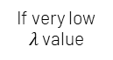
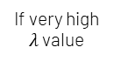
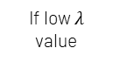
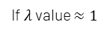
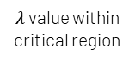
Methodology
Unknown Program
Works on a dual-core platform.
Program running on Core 2 is isolated from Core 1 using Cuckoo Sandboxing.
Execute the Program
Collect Features
If very low $λ$ value
Univariate Analysis
If very high $λ$ value
Allow to Execute
$λ$ value within critical region
Terminate
If low $λ$ value
Multivariate Analysis
If $λ$ value $≈1$
Core 1
Core 2

Slide 18
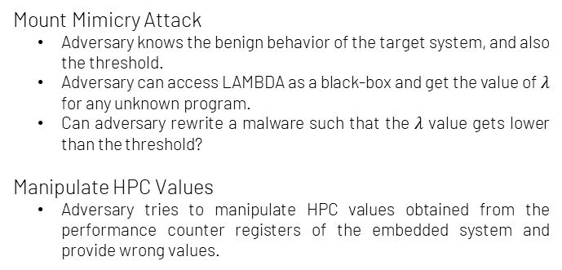
Security Analysis of LAMBDA
Two primary assumptions behind LAMBDA are:
The benign behavior of the embedded system is known.
The performance counters are difficult to manipulate by an adversary.
Attack Strategy
Mount Mimicry Attack
Adversary knows the benign behavior of the target system, and also the threshold.
Adversary can access LAMBDA as a black-box and get the value of $λ$ for any unknown program.
Can adversary rewrite a malware such that the $λ$ value gets lower than the threshold?
Manipulate HPC Values
Adversary tries to manipulate HPC values obtained from the performance counter registers of the embedded system and provide wrong values.
Mount Mimicry Attack
Manipulate HPC Values

Slide 19
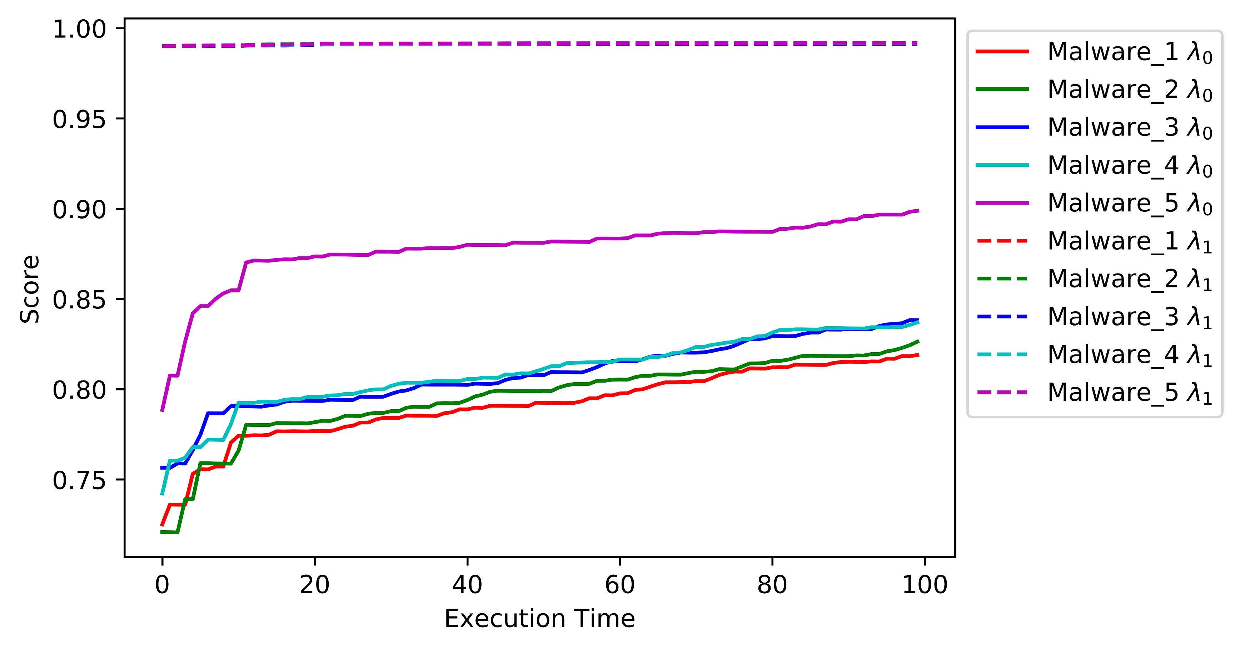
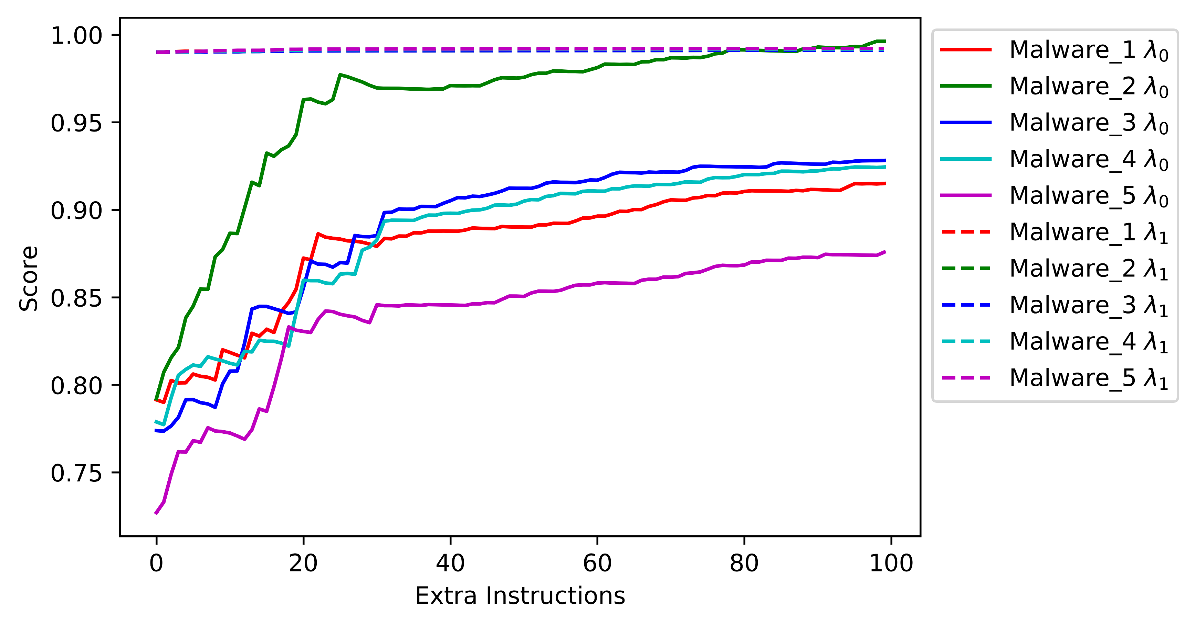

Security Analysis of LAMBDA
Resistance against Mimicry Attack
We increased the execution time of these malwares by slowing them down. The increase in execution time will give rise to marginally higher HPC values than the original.
We added extra instructions along with the existing ones in the malware codes. We did not remove any instructions since all the instructions are required to carry out their malware intentions
Impractical to change HPC Values
The HPC values are measured by perf tool, which uses perf_event_open system call in the background. There is a provision to reset the performance counter values forcefully to 0 by PERF_EVENT_IOC_RESET ioctl call. However, execution of this call is only possible with an administrator privilege.
If any adversary finds a way to decrease the $λ$ values, then it will be easier to bypass the scheme.

Slide 20
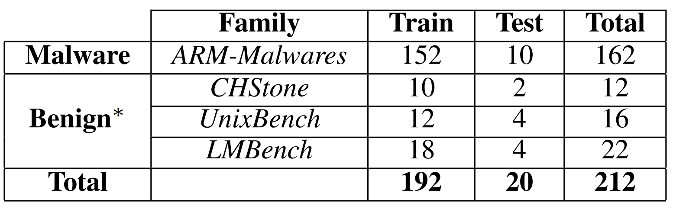
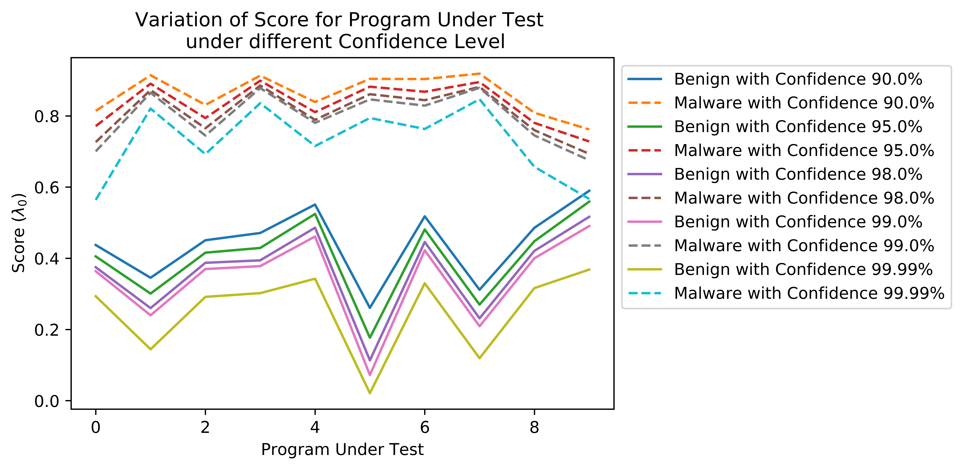
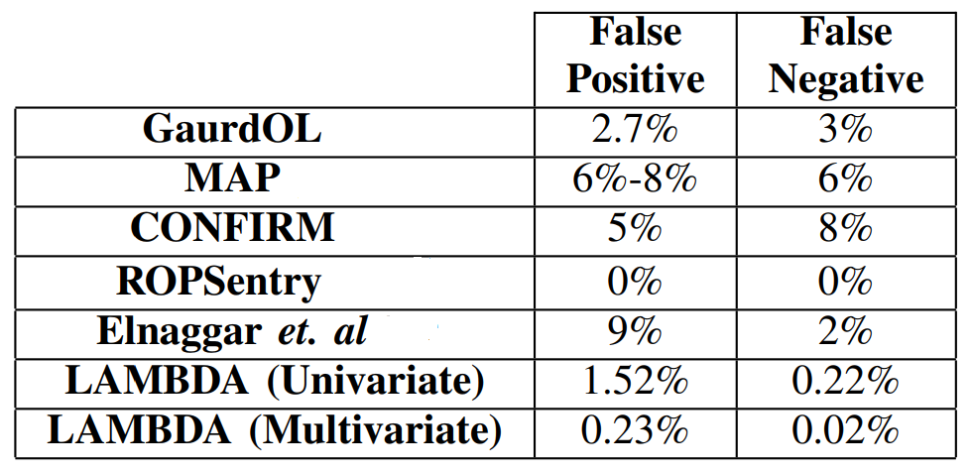
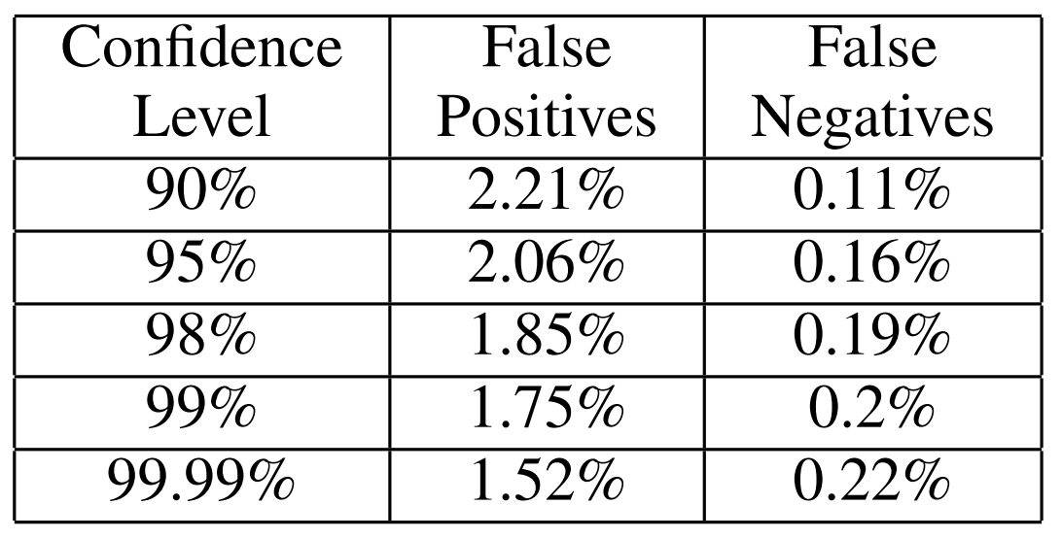
Results
Selecting the appropriate confidence level for hypothesis testing
Dataset used for Analysis
Comparison with State-of-the-art
Separability increases with increase in confidence level
We considered 90% significance level for the hypothesis testing.

Slide 21
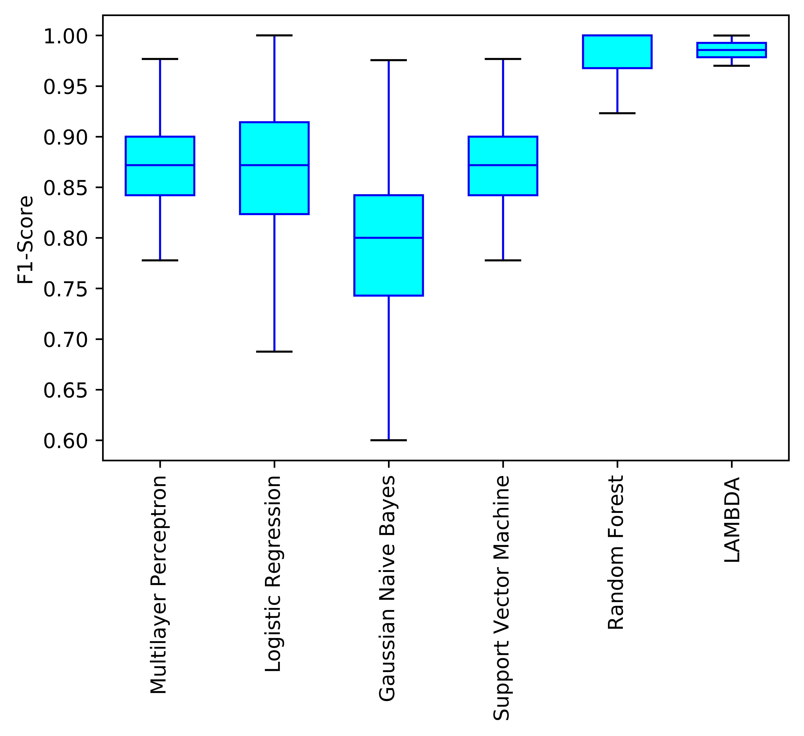
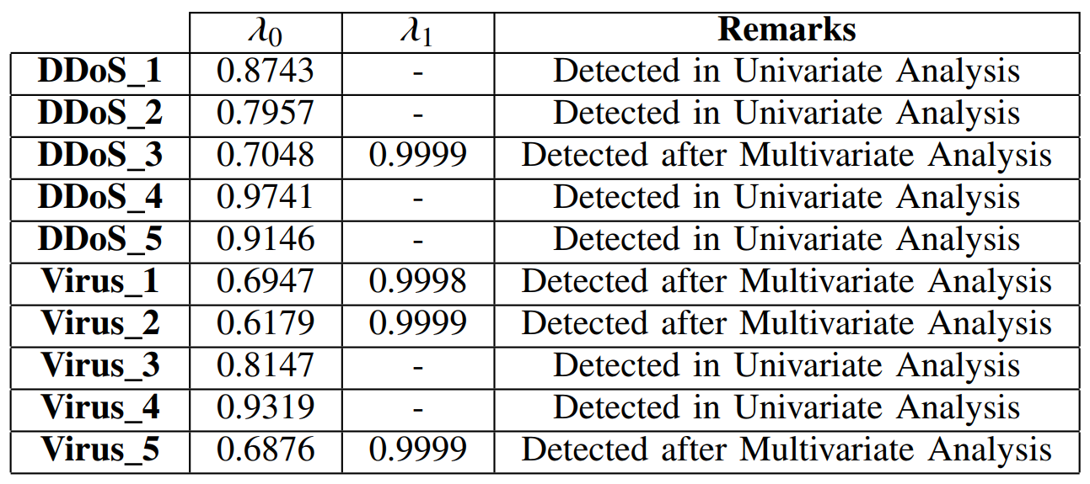
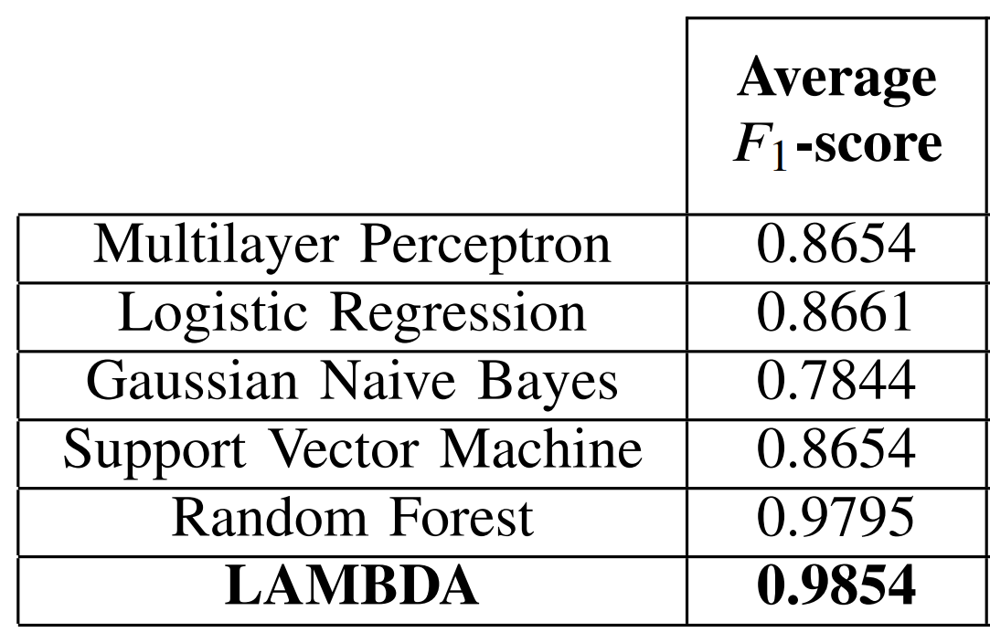
Results
Comparison with Machine Learning Classifiers
Resilience against Zero-day Attacks

Slide 22

Can we improve the Accuracy More??
We proposed the concept of Sensitivity Matrix to give importance to feature in the offline phase.
Is the matrix optimum?
Is there any other matrix which gives better separability between benign and malware programs, such that the decision does not depend on any threshold?
We next propose a new formulation to optimize the matrix.
We feedback the error in calculating LAMBDA and update the weights accordingly.

Slide 23

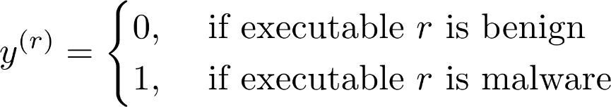
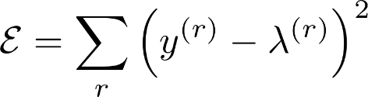
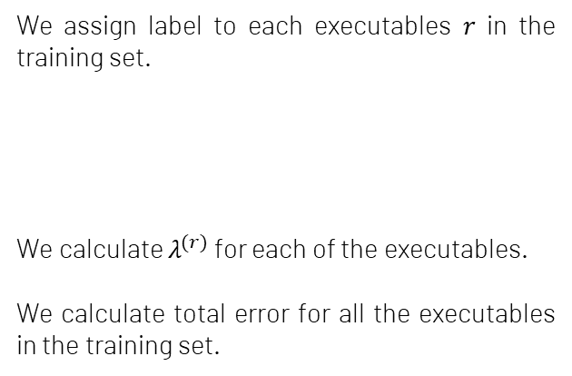
Error in Judgement
We assign label to each executables 𝑟 in the training set.
We calculate $λ^{(r)}$ for each of the executables.
We calculate total error for all the executables in the training set.

Slide 24
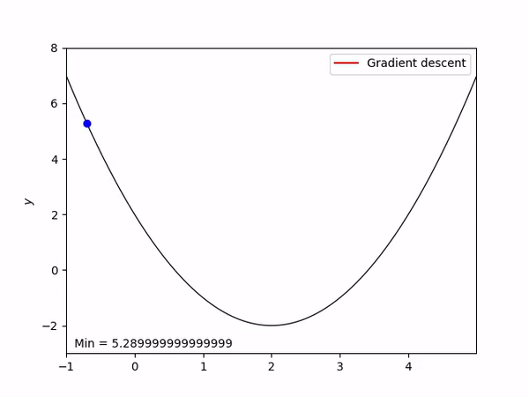
Optimize the Matrix
The main objective is to adjust the weights such that the error is minimized.
If a change in weight increases (decreases) the error, then we want to decrease (increase) that weight.
Mathematically, this means that we look at the derivative of the error with respect to the weight and adjust the weight in the negative direction of the derivative to minimize error.
We repeat the updation process successively until we reach at (near) optimum value of the error.

Slide 25
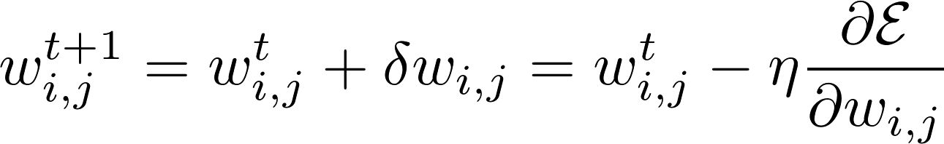
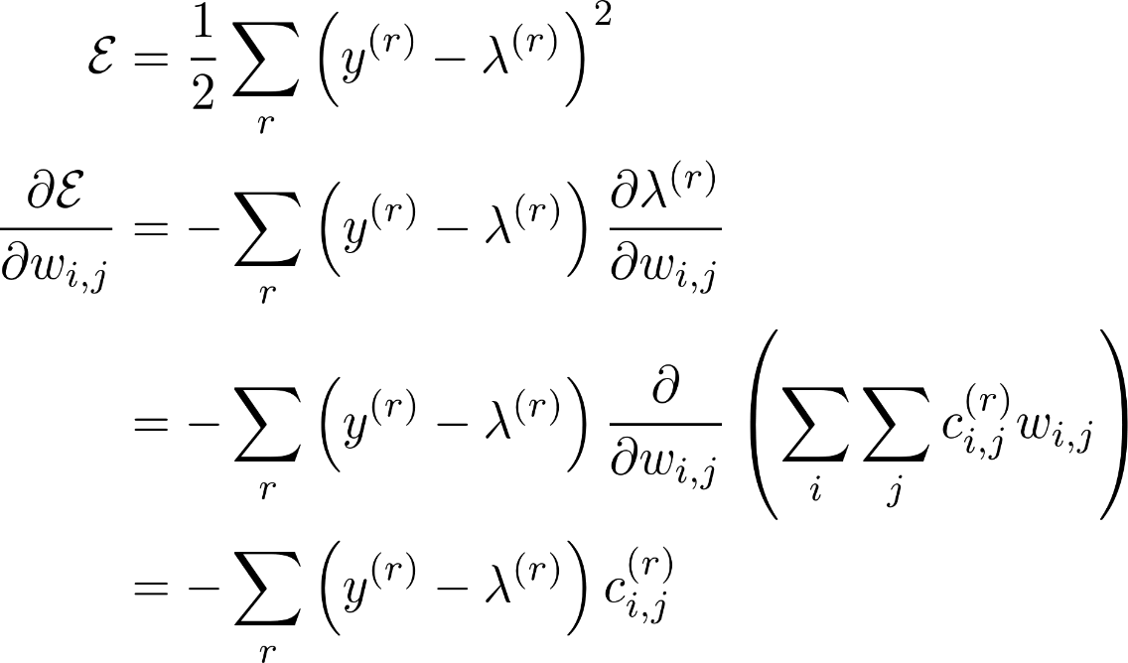
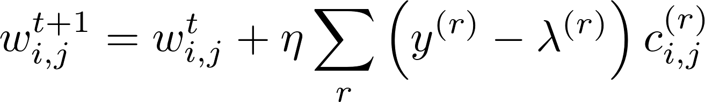
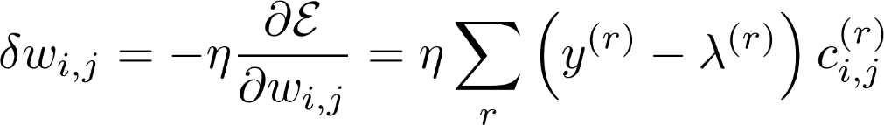
Optimize the Matrix
Updated Matrix Values

Slide 26
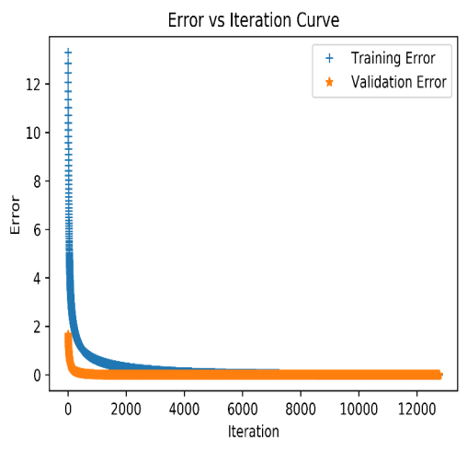
Results
Gradual decrease in error
The weight updation does not over fit for our example as both the errors decrease with increase in iterations and gradually saturate to optimum value.

Slide 27
DEMO

Slide 28
RAPPER: RAnsomware Prevention via PERformance counters

Slide 29
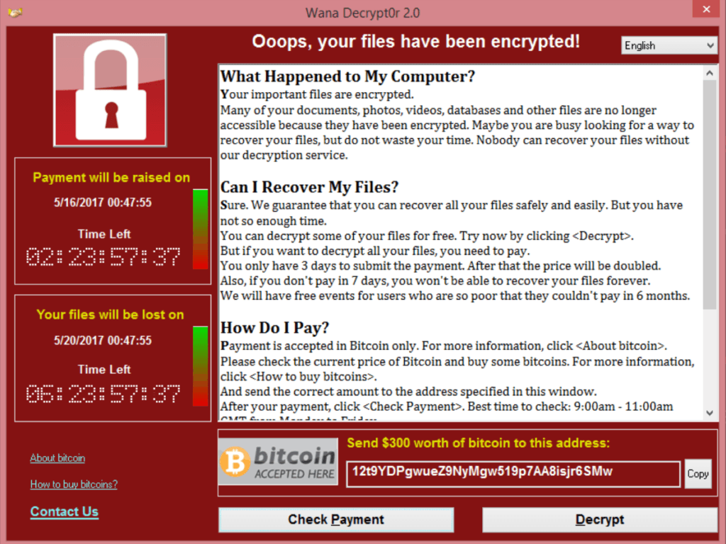
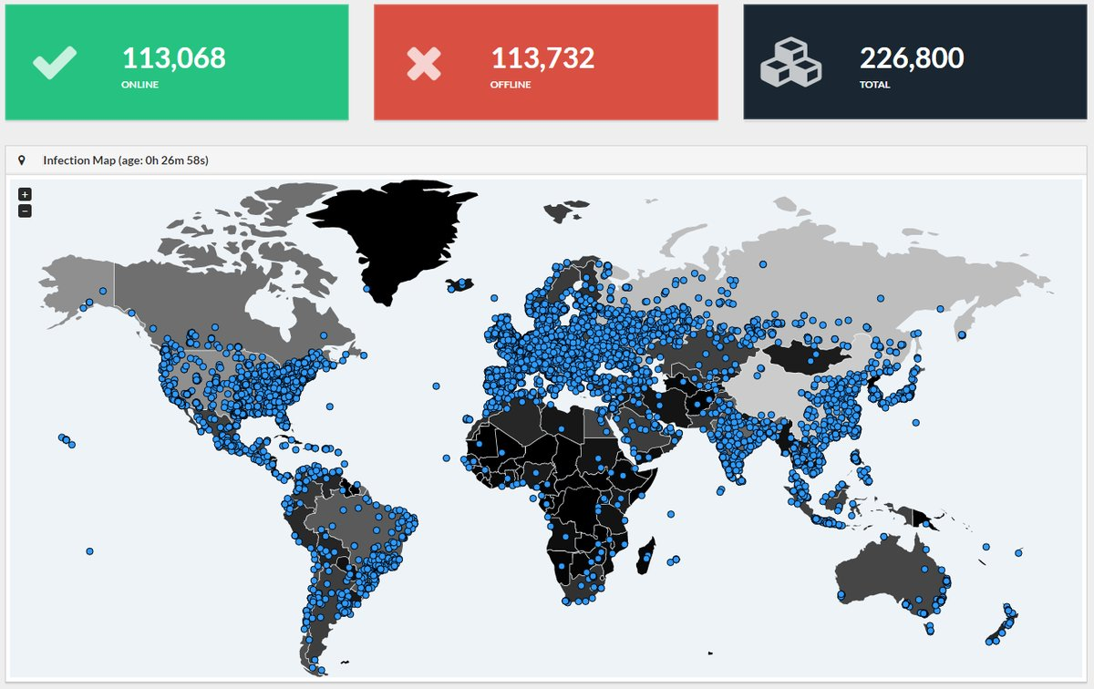
Threat of WannaCry
In May 2017, WannaCry ransomware has affected approximately 200,000 business across 150 countries.
One of the most familiar images of 2017

Slide 30
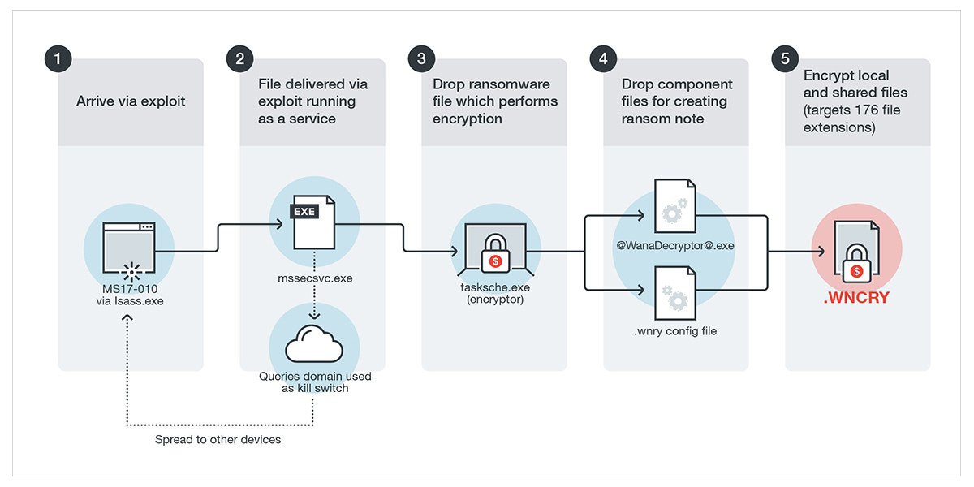



What is a Ransomware??
Ransomware is a type of malicious software from cryptovirology that encrypts certain file types on infected systems and forces users to pay the ransom through certain online payment methods to get a decrypt key.

Slide 31









Damages by WannaCry
Up to 70,000 devices - including computers, MRI scanners, blood-storage refrigerators and theatre equipment of National Health Service hospitals in England and Scotland and have been affected.
Nissan Motor Manufacturing UK in Tyne and Wear, England, halted production after the ransomware infected some of their systems.
According to Cyber risk modelling firm Cyence, economic losses from the cyber attack could reach up to $4 billion.
And many more........
State Government of India affected by WannaCry
Government of Gujarat
Government of Kerala
Government of Maharashtra
Government of West Bengal

Slide 32
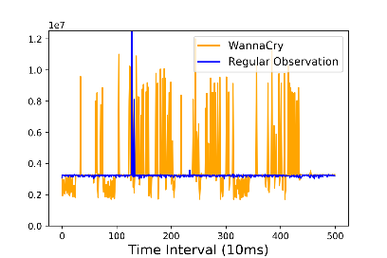




Does Ransomware affect the Performance Counters??
We observed five performance counters (in sampling mode) which are likely to be affected by Ransomware (because of its repeated encryption of files).
YES!!
Ransomware do affect these events.
Branch Instructions
Branch Misses
Cache References
Cache Misses
Instructions

Slide 33

Is it enough to observe a single sample point??
It is better to consider the performance counter values as multivariate time-series sequence of specific window size.
Branch Instructions
Branch Instructions
Can not differentiate by observing a single point
The difference is more clear within a specific window

Slide 34











LSTM based Autoencoder
LSTM network (a Deep Neural Network) is typically used for modelling sequence data, which efficiently handles the dependencies within a sequence.
The goal of the Autoencoder is to learn the time-series structure by minimizing the reconstruction error (the mean square error between input data and reconstructed data) for all the inputs.
$$f:$$
$$χ$$
$$→$$
$$χ$$
Input
Reconstructed Input
$$φ:$$
$$χ$$
$$→$$
$$F$$
$$ψ:$$
$$F$$
$$→$$
$$χ$$
Latent Space
$$L= {\left\|χ −(ψ ο φ)χ\right\|}^{2}$$
Reconstructed Error

Slide 35




First Step: Detecting the Anomaly
We collect performance counter data by sliding the observation window after each interval of 10ms and model the normal system behavior using an LSTM based Autoencoder.
Threshold is calculated by 3σ analysis on the normal behavior.
Advantages of modeling normal behavior.
We do not model the behavior of ransomware as there can be new ransomware at any point of time.
We do not need to label the dataset as any behavior higher than the normal behavior by a threshold can be treated as anomaly.

Slide 36


How good is reconstruction error as a decider??
The analysis of SPEC 2006 server and multimedia benchmark, and CHStone Linux benchmark show different results.
The execution behavior of these benchmark suites are significantly different from the normal observations along with different ransomware programs.
Only the reconstuction error is not enough for detecting Ransomware, since SPEC and CHStone programs also act as anomalies.

Slide 37





Utilizing the fact of Repeated Encryption of Ransomwares
The Ransomware executable runs encryption repeatedly on multiple files.
Transform the traces from the time domain to the frequency domain using the Fast Fourier Transformation (FFT) to understand the repetitive pattern of the traces.
The transformation indicates that the amplitude for each frequency bins are constantly higher for the ransomware in contrary to the benchmark.

Slide 38






Second Step: Detecting Anomaly in Frequency Domain
The variations of amplitudes for different frequency bins can be again considered as a time-series data, and another LSTM based autoencoder, as discussed before, can be used to detect the anomaly.
Threshold is calculated by 3σ analysis on the normal FFT behavior.

Slide 39


What should I do with him?
You have not considered me !!
RAPPER
Disk Encryption

Slide 40




Third Step: Identifying Disk Encryption Process
Disk Encryption processes are very similar in operation to the malicious ransomware processes, though the intentions of the processes are entirely different.
Popular disk encryption processes like TrueCrypt and VeraCrypt are detected as ransomwares by RAPPER.
One naive solution is to check the privilege of the current process under suspicion. Since the disk encryption processes can only be run by the administrator with the highest privilege.

Slide 41


Third Step: Identifying Disk Encryption Process
All the popular disk encryption processes use AES-XTS mode of encryption for their operations.
We template the operation of a disk encryption process, and check for whether the suspicious program is a disk encryption process or not.
We calculate cumulative correlation over time for the suspicious process.
If the correlation is high for a successive interval of time, we conclude that the process is a disk encryption process.
What about Ransomwares having disk encryption as a subroutine? (MAMBA Ransomware)
We temporary suspend the disk encryption program and wait for a confirmation from the user whether the suspected program is actually launched by the user.

Slide 42


Unknown Process
Disk Encryption
Methodology
Normal Observation
RAPPER Tool
Watchdog Program
Autoencoder_1
FFT Module
Error >
$$R_{t}$$
Online Phase
Offline Phase
Autoencoder_2
Error >
$$R_{t}^{′}$$
Correlation Module
High Correlation
Low Correlation
Wait for Confirmation
Ransomware Process

Slide 43



Discussion on File Recovery
Depending on the detection latency, the ransomware can encrypt few files (say n).
A practical solution would be to take backups of the n-recently opened files. After the lapse of the time quantum required to encrypt these files, we delete the copies if no ransomware alarm is raised by RAPPER.
This minimizes the storage necessary for the backup files.
To further ensure that the backup files are not encrypted we perform locking operation, like in Linux using mlock().
mlock()

Slide 44
DEMO

Slide 45
THANKS!
You can find me at:
alam.manaar@iitkgp.ac.in
Any questions?

